Slide 1
Individual Homework
Iaguța Alen-Mihael

Slide 2
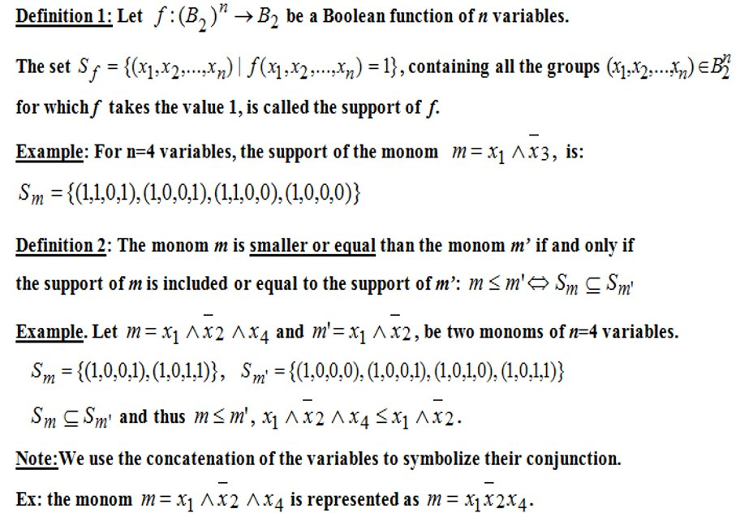
Theoretical results:

Slide 3
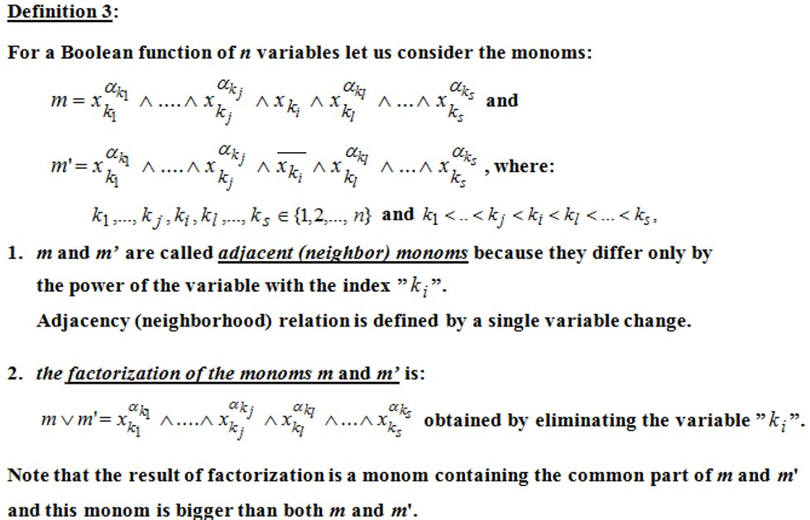

Slide 4
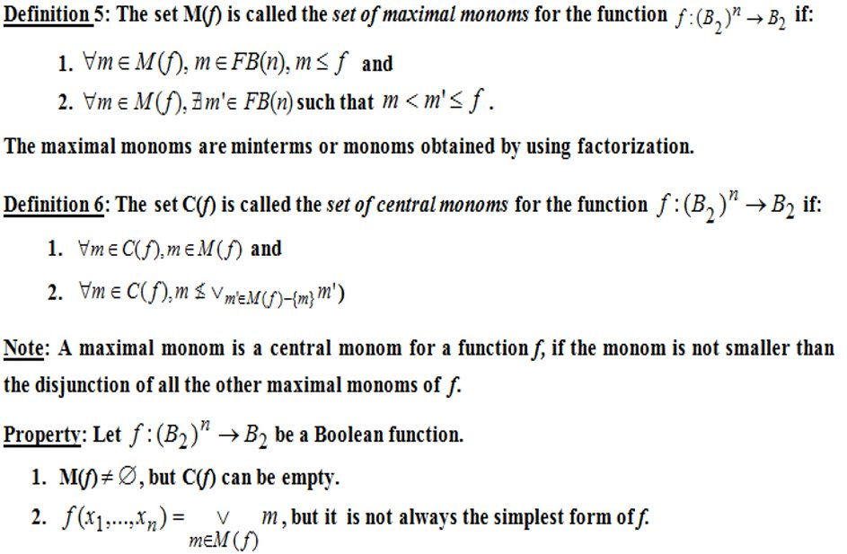

Slide 5
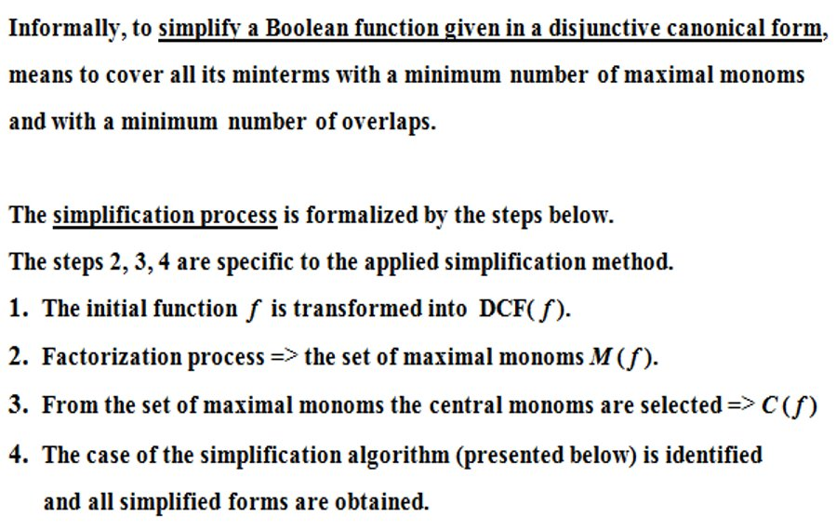

Slide 6
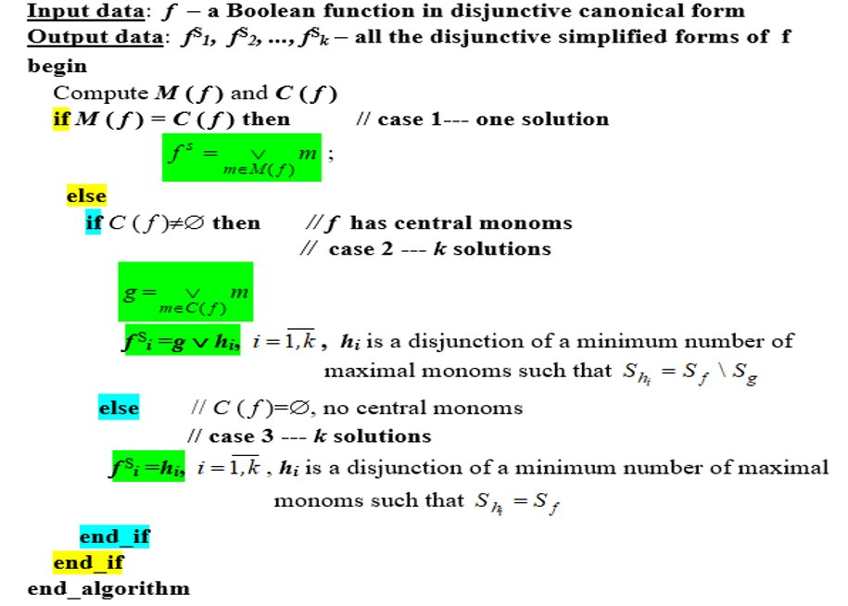

Slide 7
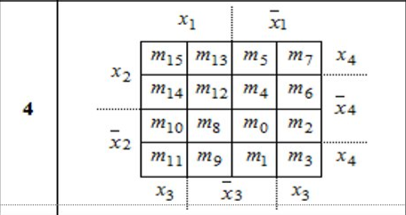
In our case we use the Veitch diagram with 4 variables:

Slide 8
Problem Statement:
Exercise 4.8
Simplify the following Boolean functions of 4 variables using Veitch diagrams
8. f8(x1,x2,x3,x4) = x3x4 ∨ x1¯x2x3¯x4 ∨ ¯x2¯x3¯x4 ∨ ¯x1¯x3 ∨ ¯x1x4

Slide 9
f8(x1,x2,x3,x4) = x3x4 ∨ x1¯x2x3¯x4 ∨ ¯x2¯x3¯x4 ∨ ¯x1¯x3 ∨ ¯x1x4
= (m15 V m11 V m7 V m3) V m10 V (m0 V m10) V (m0 V m1 V m4 V m5) V (m1 V m3 V m5 V m7)
x3x4 = (x1 x2 x3 x4) ∨ (x1 ¯x2 x3 x4) ∨ (¯x1 x2 x3 x4) ∨ (¯x1 ¯x2 x3 x4)
m15 m11 m7 m3
¯x2¯x3¯x4 = (¯x1 ¯x2 ¯x3 ¯x4) ∨ (x1 ¯x2 x3 ¯x4)
m0 m10
¯x1¯x3 = (¯x1 ¯x2 ¯x3 ¯x4) ∨ (¯x1 ¯x2 ¯x3 x4) ∨ (¯x1 x2 ¯x3 ¯ x4) ∨ (¯x1 x2 ¯x3 x4)
m0 m1 m4 m5
¯x1x4 = (¯x1 ¯x2 ¯x3 x4) ∨ (¯x1 ¯x2 x3 x4) ∨ (¯x1 x2 ¯x3 x4) ∨ (¯x1 x2 x3 x4)
m1 m3 m5 m7
f8(x1,x2,x3,x4) = (x1 x2 x3 x4) ∨ (x1 ¯x2 x3 x4) ∨ (¯x1 x2 x3 x4) ∨ (¯x1 ¯x2 x3 x4) V (x1 ¯x2 x3 ¯x4) V (¯x1 ¯x2 ¯x3 ¯x4) ∨ dsdaddasdasdsa(x1 ¯x2 x3 ¯x4) V (¯x1 ¯x2 ¯x3 ¯x4) ∨ (¯x1 ¯x2 ¯x3 x4) ∨ (¯x1 x2 ¯x3 ¯ x4) ∨ (¯x1 x2 ¯x3 x4) V
ddddddddddddd(¯x1 ¯x2 ¯x3 x4) ∨ (¯x1 ¯x2 x3 x4) ∨ (¯x1 x2 ¯x3 x4) ∨ (¯x1 x2 x3 x4)
f8(x1,x2,x3,x4) = (m15 V m11 V m7 V m3) V m10 V (m0 V m10) V (m0 V m1 V m4 V m5) V (m1 V m3 V m5 V m7)
= m15 V m11 V m7 V m3 V m10 V m0 V m1 V m4 V m5

Slide 10
f8(x1,x2,x3,x4) = x3x4 ∨ x1¯x2x3¯x4 ∨ ¯x2¯x3¯x4 ∨ ¯x1¯x3 ∨ ¯x1x4
= m15 V m11 V m7 V m3 V m10 V m0 V m1 V m4 V m5
We represent the minterms in the Veitch diagram:
x1
¯x1
m15 |  | m5 | m7
 |  | m4
m10 | m8 | m0
m11 |  | m1 | m3
x4
x2
¯x4
Max1 = m0 V m1 V m4 V m5 = ¯x1¯x3
Max2 = m1 V m3 V m5 V m7 = ¯x1x4
Max3 = m3 V m7 V m11 V m15 = x3x4
Max4 = m10 V m8 = x1¯x2¯x4
Max5 = m10 V m11 = x1¯x2¯x3
Max6 = m0 V m8 = ¯x2¯x3¯x4
M(f) ={max1, max2, max3, max4, max5, max6}
C(f) = {max1, max3}
¯x2
x4
x3
¯x3
x3
x1
¯x1
m15 |  | m5 | m7
 |  | m4
m10 | m8 | m0
m11 |  | m1 | m3
x4
x2
¯x4
¯x2
x4
x3
¯x3
x3

Slide 11
Since C(f) != M(f) and C(f) != ∅, we are in the second case, where every simplification must contain all central monoms and then complete with maximal monoms until we cover all the minterms, so:
Max1 = m0 V m1 V m4 V m5 = ¯x1¯x3
Max3 = m3 V m7 V m11 V m15 = x3x4
Therefore we need to cover m10 and m8, which we can do by using Max4 = m10 V m8 = x1¯x2¯x4
x1
¯x1
m15 |  | m5 | m7
 |  | m4
m10 | m8 | m0
m11 |  | m1 | m3
x4
x2
¯x4
¯x2
x4
x3
¯x3
x3
In conclusion, we get the disjunctive simplified form of f8(x1,x2,x3,x4) = x3x4 ∨ x1¯x2x3¯x4 ∨ ¯x2¯x3¯x4 ∨ ¯x1¯x3 ∨ ¯x1x4:
Fs8(x1,x2,x3,x4) = ¯x1¯x3 V x3x4 V x1¯x2¯x4

